Slide 1
PayPal + Flex = Payments anywhere
RIAUnleashed Boston 2011

Slide 2
Who am I?
Sidney Maestre
Developer Evangelist - X.commerce (eBay)
Adobe Community Professional
ColdFusion, Flex, jQuery, Sencha
Mobile Enthusiast - BAM! – Bay Area Mobile Meetup
Twitter - @SidneyAllen

Slide 3

PayPal Stats
100 million active users
190 countries
25 currencies
Trusted brand for online payments

Slide 4
Use Cases
Commerce (electronic, mobile, social)
Person 2 Person
Subscriptions
Donations
Virtual Goods
Digital Goods
Marketplaces

Slide 5
Virtual Goods

Slide 6
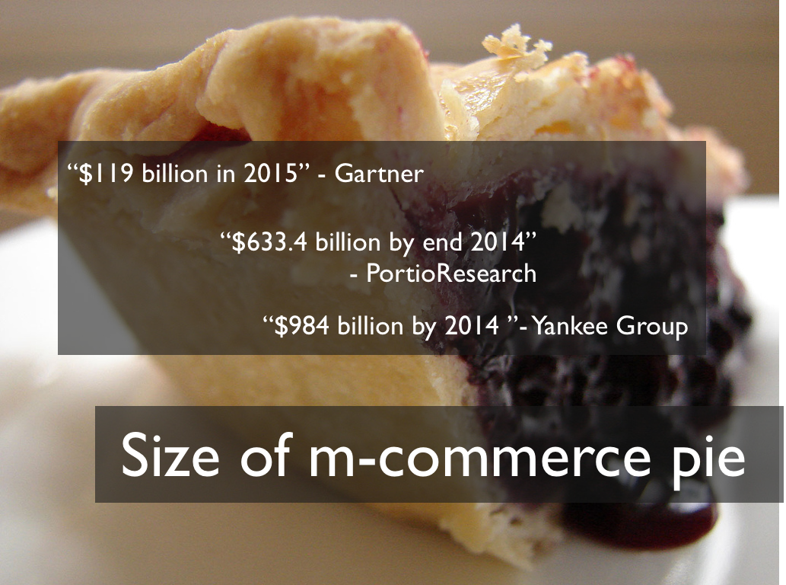
Mobile Commerce

Slide 7




Payments Anywhere?

Slide 8
Payments Anywhere?
APIs

Slide 9
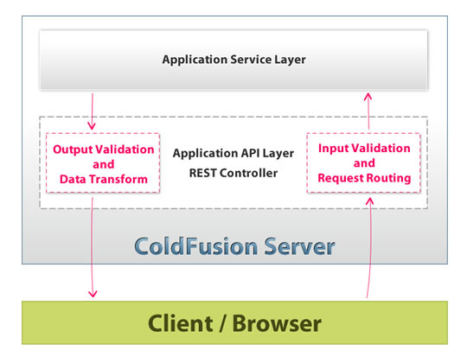
Typical RESTful API

Slide 10
How are PAYPAL APIS Different?

Slide 11
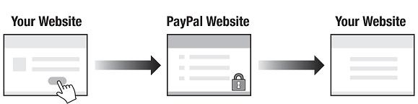
Website Payments Standard

Slide 12
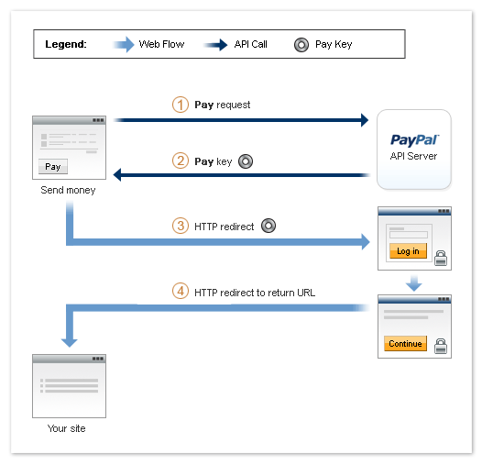
Explicit Approval Payment Flow

Slide 13
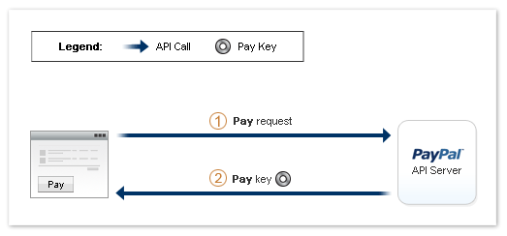
Implicit Approval Payment Flow

Slide 14
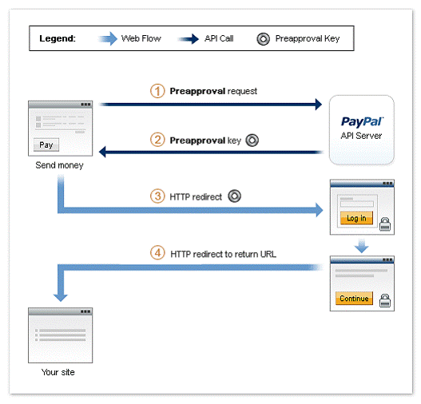
Pre Approval Payment Flow

Slide 15
Preapproved Payment

Slide 16
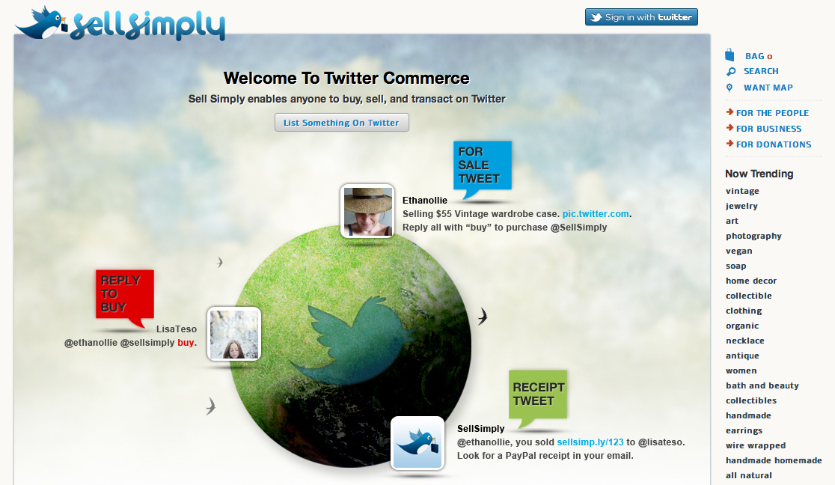
Social Marketplace

Slide 17
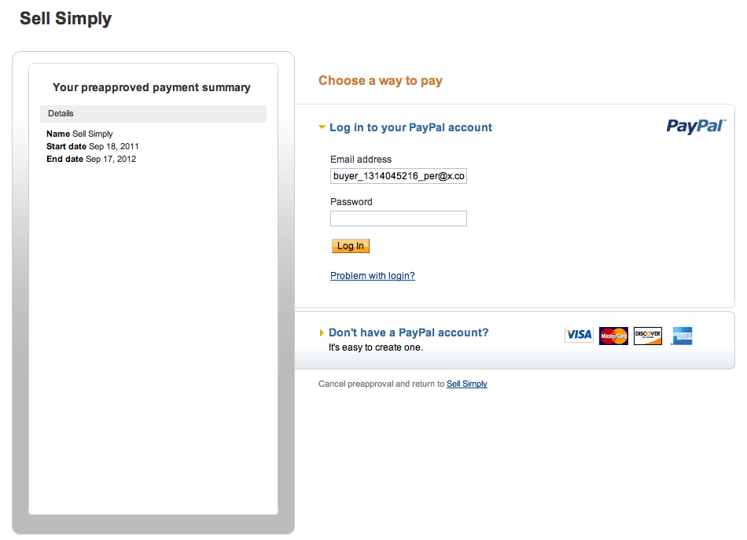
Authorize SellSimp.ly

Slide 18
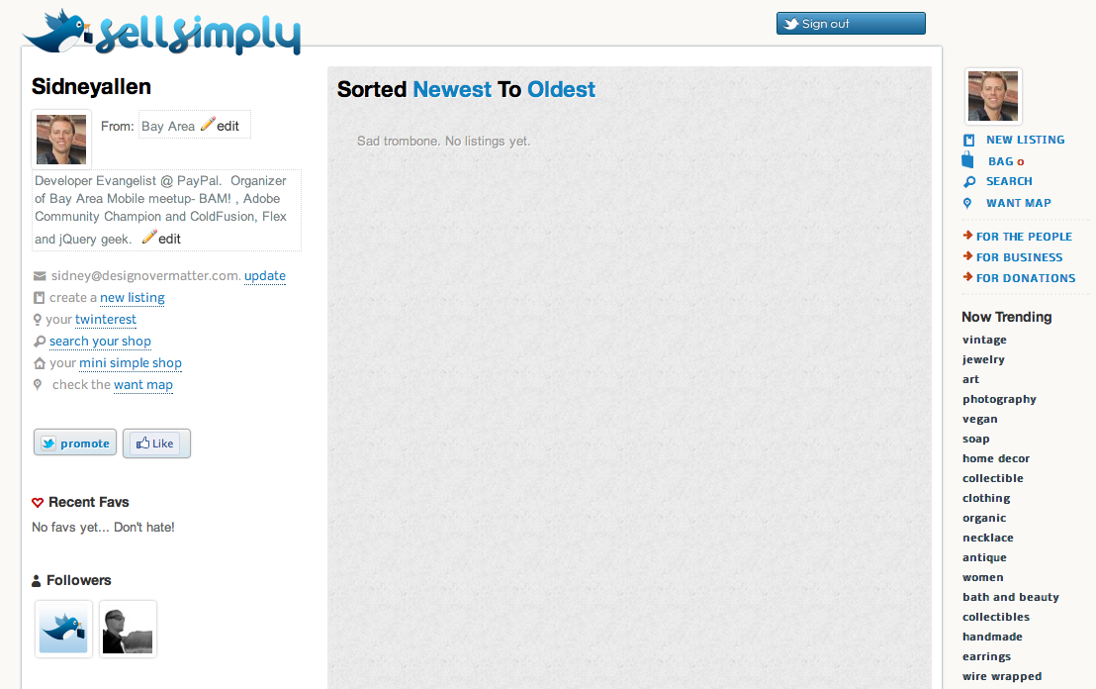
Sell, buy and promote via twitter

Slide 19
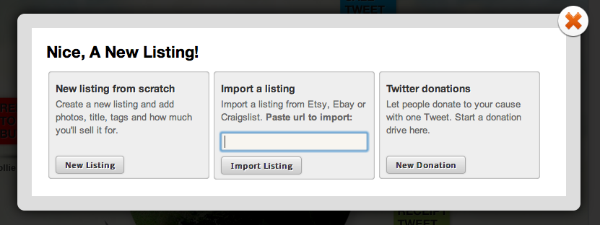
Import your listings

Slide 20
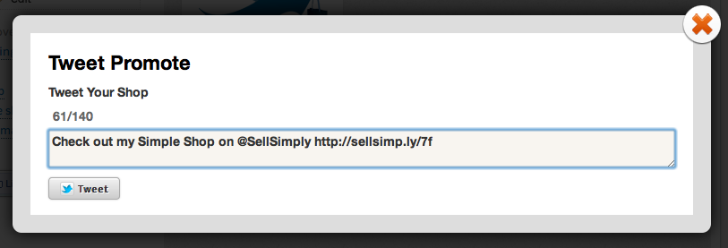
Promote your storefront

Slide 21
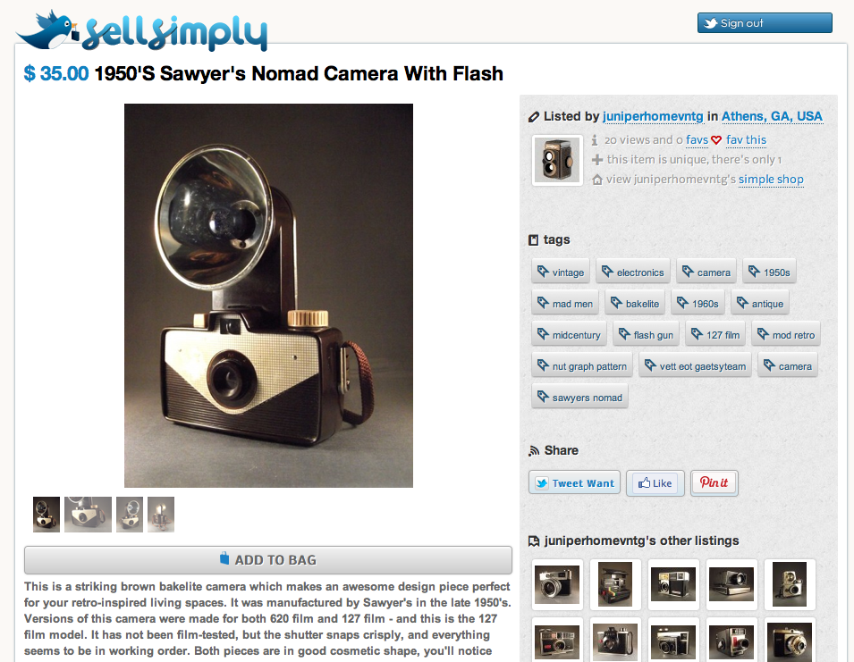
Sample Listing

Slide 22
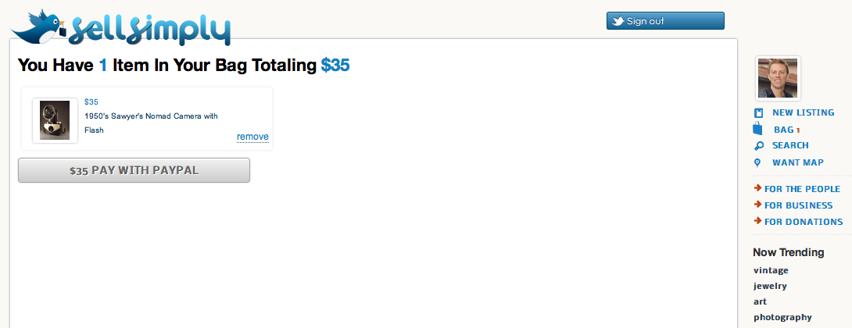
Pay with PayPal

Slide 23
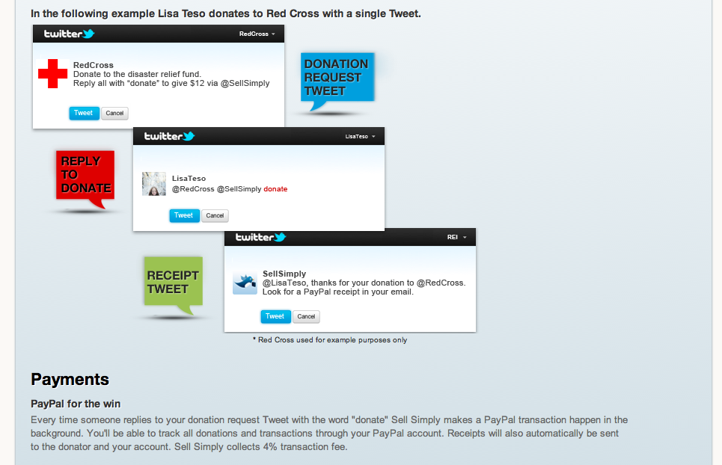
Request and Collect Donations

Slide 24
How to get Started

Slide 25
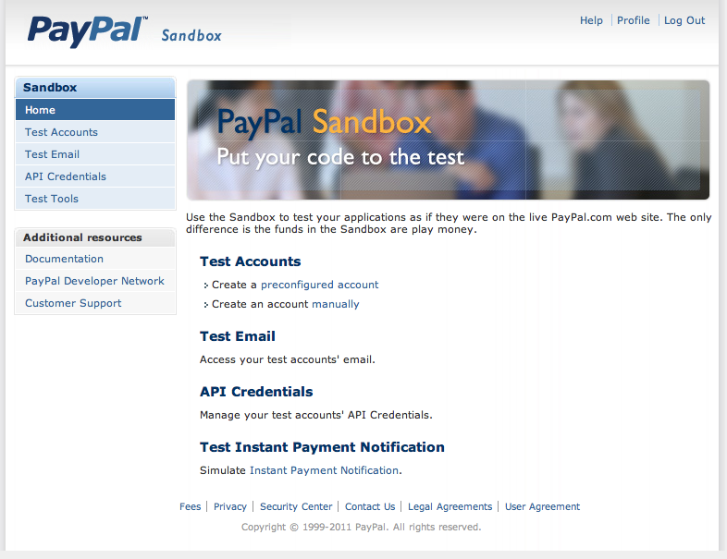
Developer Console
developer.paypal.com
Test Accounts
Test Emails
API Credentials
IPN Simulator

Slide 26
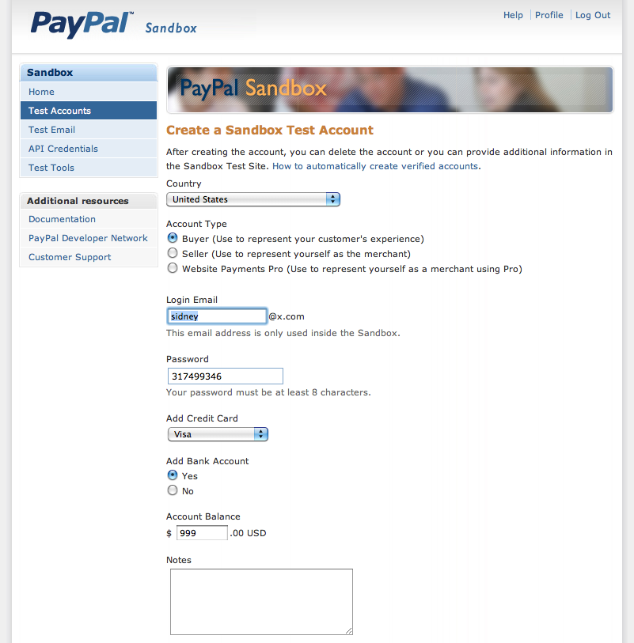
Preconfigured Accounts
Buyer, Seller or Merchant
You choose prefix for email
Add up to $999 to your bank account

Slide 27
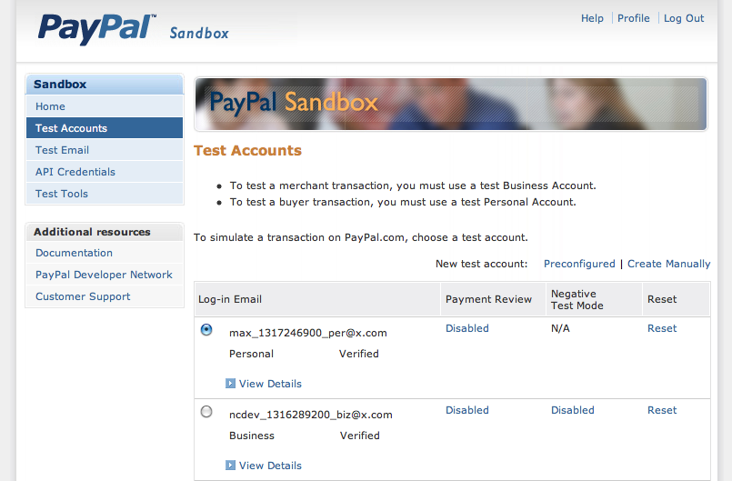
Unlimited Test Accounts *
* Not intended to be a factual statement

Slide 28
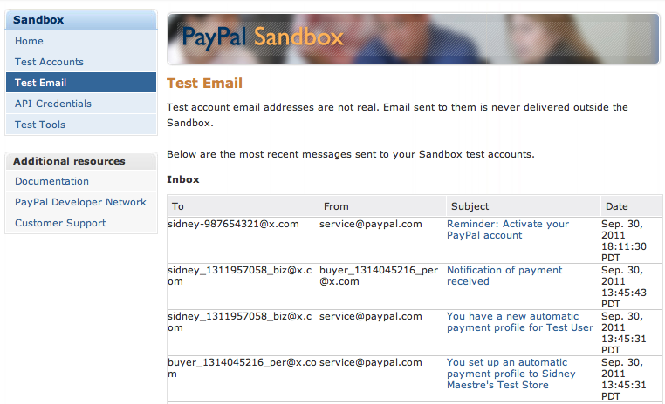
Test Emails

Slide 29
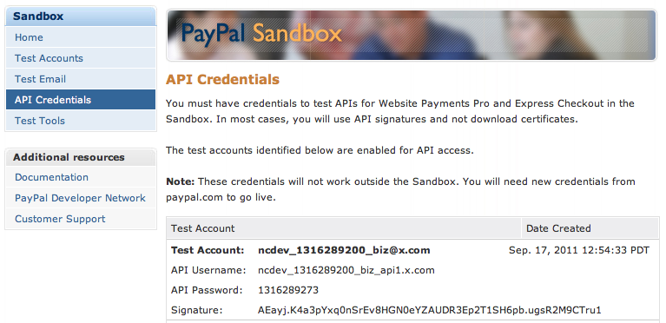
API Credentials

Slide 30
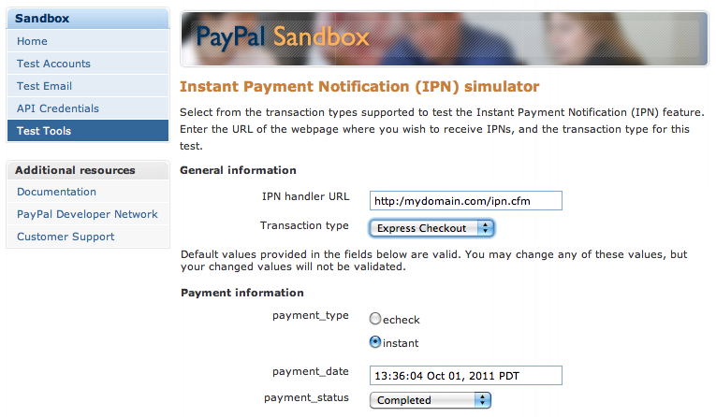
IPN Simulator

Slide 31
TOOLS

Slide 32
SDKs
JAVA, PHP, ColdFusion, .NET, Ruby, Python
NVP – Name Value Pair
SOAP
Newer APIs support JSON and XML payload and response

Slide 33
Flex Mobile and Express Checkout

Slide 34
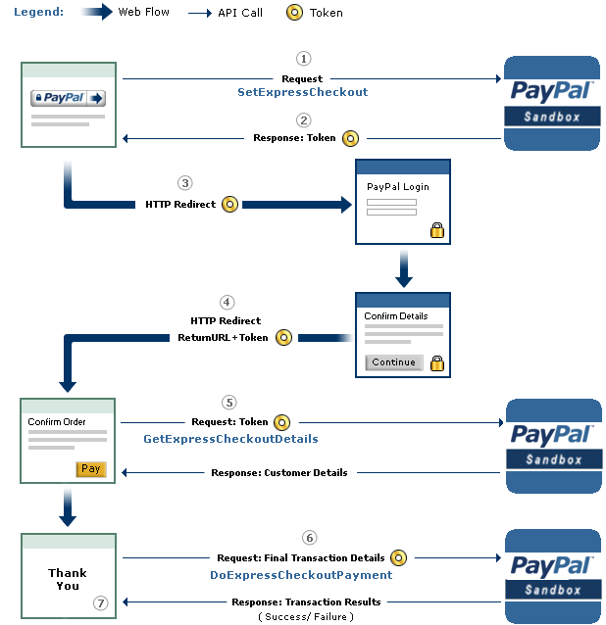
Express Checkout Payment Flow

Slide 35
Quick Demo of the App

Slide 36
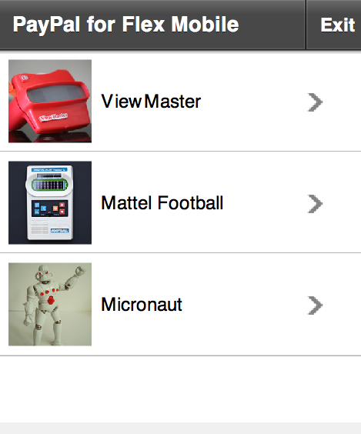
List View

Slide 37
Passing data to detail view
protected function list_changeHandler(event:Event):void
{
model.item = list.selectedItem.item;
navigator.pushView(Detail,model);
}

Slide 38
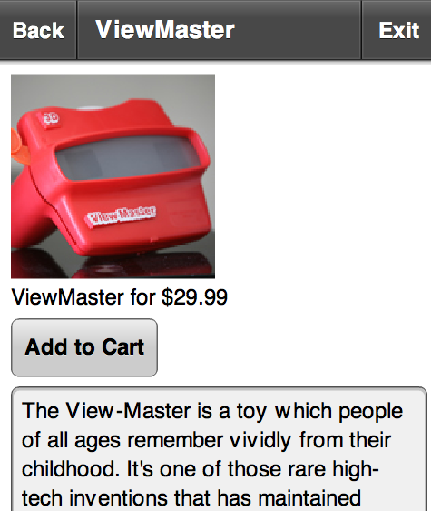
Detail View

Slide 39
Add item to cart
private function addToCart():void
{
var myAC:ArrayCollection = model.cart;
if( getItemIndexByProperty(model.cart,'id',String(model.item.id) ) ) {
myAC.addItem(model.item);
}
model.cart = myAC;
navigator.pushView(Cart, model);
}

Slide 40
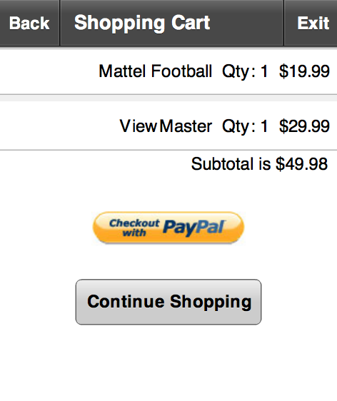
Shopping Cart

Slide 41
StageWebView
<mobile:StageWebViewUIComponent
xmlns:mobile="com.soenkerohde.mobile.*"
id="stageWebView” locationChanging="stageWebView_locationChangingHandler(event)”
locationChange="stageWebView_locationChangeHandler(event)"/>

Slide 42
payWithPayPal() method
isCheckout = true;
currentState="Wait";
continueShoppingButton.visible = false;
var urlVar: URLVariables = new URLVariables();
urlVar.paymentAmount = getSubTotal(model.cart).toFixed(2);
var cartArray:ArrayCollection = model.cart;

Slide 43
Checkout with PayPal continued
for (var i:Number = 0; i < cartArray.length; i++)
{
var obj:Object = Object(cartArray[i])
urlVar['L_NAME' + i] = obj["name"];
urlVar['L_NUMBER' + i] = obj["id"];
urlVar['L_QTY' + i] = obj["qty"];
urlVar['L_AMT' + i] = obj["price"];
}
urlVar.n = cartArray.length;
stageWebView.url="http://localhost/PayPalFlex/startPaymentFlex.php?" + urlVar

Slide 44
On our Server
Example code uses PHP
We have SDKs for ColdFusion, .NET, Java, etc

Slide 45
API Credentials
define('API_USERNAME', 'sidney_1300905880_biz_api1.designovermatter.com');
define('API_PASSWORD', '1300905887');
define('API_SIGNATURE', 'AW-u29OhQHbSoMS0KjiA4WshXplWg9c1');

Slide 46
Endpoints and Redirect URL
define('API_ENDPOINT', 'https://api-3t.sandbox.paypal.com/nvp');
define('PAYPAL_URL', 'https://www.sandbox.paypal.com/webscr&cmd=_express-checkout-mobile&token=');

Slide 47
Payment Information
$paymentAmount = $_REQUEST ['paymentAmount'];
$currencyCodeType = 'USD';
$paymentType = 'Sale';

Slide 48
Item Details
for ($i = 0; $i <= $n; $i++) {
$namekey = "L_NAME$i";
$namevalue = $_REQUEST ["L_NAME$i"];
$items .= $namekey . '=' . $namevalue;
$items .= '&';
$numberkey = "L_NUMBER$i";
$numbervalue = $_REQUEST ["L_NUMBER$i"];
$items .= $numberkey . '=' . $numbervalue;
$items .= '&';
….
}

Slide 49
Return and Cancel URL
$returnURL = urlencode ( $url . '/GetExpressCheckoutDetails.php?currencyCodeType=' . $currencyCodeType . '&paymentType=' . $paymentType . '&paymentAmount=' . $paymentAmount );
$cancelURL = urlencode ( "$url/cancel.php?paymentType=$paymentType" );

Slide 50
API call with SetExpressCheckout
$resArray = hash_call ( "SetExpressCheckout", $nvpstr );
$_SESSION ['reshash'] = $resArray;
$ack = strtoupper ( $resArray ["ACK"] );
if ($ack == "SUCCESS") {
$token = urldecode ( $resArray ["TOKEN"] );
$payPalURL = PAYPAL_URL . $token;
header ( "Location: " . $payPalURL );
} else {
$location = "APIError.php";
header ( "Location: $location" );
}

Slide 51
stageWebView_locationChangeHandler
trace("location change " + event.location);
var str:String = event.location;
if(isCheckout) {
if (str.indexOf("https://www.sandbox.paypal.com/") > -1)
{
stageWebView.show();
}
}

Slide 52
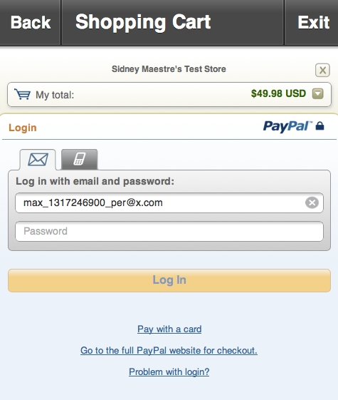
PayPal Login

Slide 53
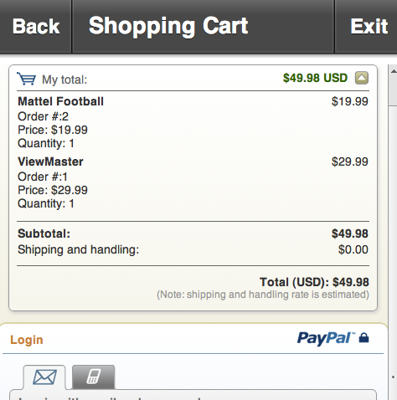
PayPal Login

Slide 54
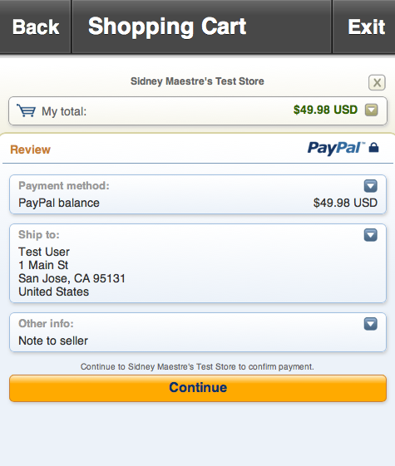
PayPal Login

Slide 55
Return URL does 2nd API call
$token = urlencode ( $_REQUEST ['token'] );
$nvpstr = "&TOKEN=" . $token;
$resArray = hash_call ( "GetExpressCheckoutDetails", $nvpstr );

Slide 56
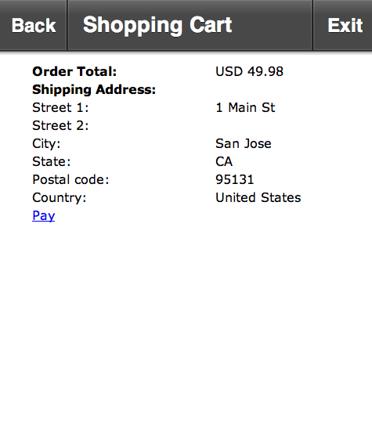
Order Review

Slide 57
Pay – DoExpressCheckoutPayment
$token =urlencode( $_SESSION['token']);
$paymentAmount =urlencode ($_SESSION['paymentAmount']);
$paymentType = urlencode($_SESSION['paymentType']);
$currCodeType = urlencode($_SESSION['currCodeType']);
$payerID = urlencode($_SESSION['payer_id']);
$serverName = urlencode($_SERVER['SERVER_NAME']);
$resArray=hash_call("DoExpressCheckoutPayment",$nvpstr);

Slide 58
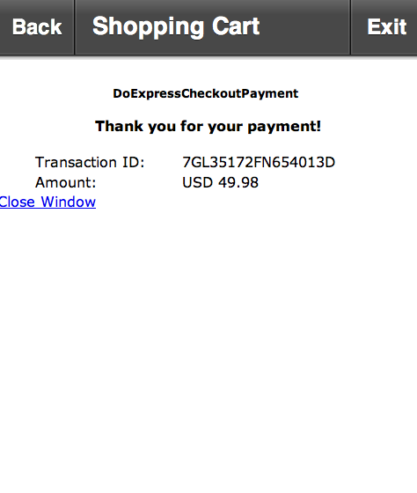
Order Review

Slide 59
stageWebView_locationChangeHandler
if ( (str.indexOf("close.php") > -1) ) {
model.cart = new ArrayCollection();
stageWebView.hide();
currentState="Start";
navigator.pushView(views.Complete);
continueShoppingButton.visible = true;
buyButton.selected = false;
}

Slide 60
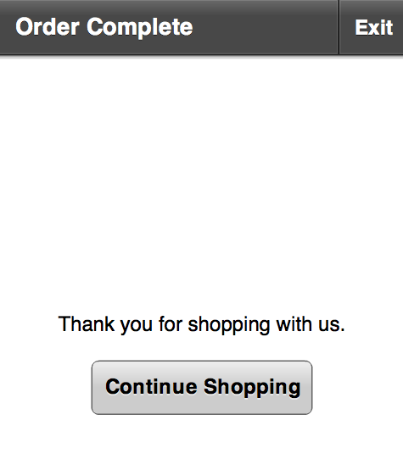
Completed

Slide 61
Cancel URL
if ( (str.indexOf("cancel.php") > -1) ) {
stageWebView.hide();
currentState="Start";
continueShoppingButton.visible = true;
buyButton.selected = false;
}

Slide 62
Less Clicks = More $$
define('PAYPAL_URL', 'https://www.sandbox.paypal.com/webscr&cmd=_express-checkout-mobile&useraction=commit&token=');

Slide 63
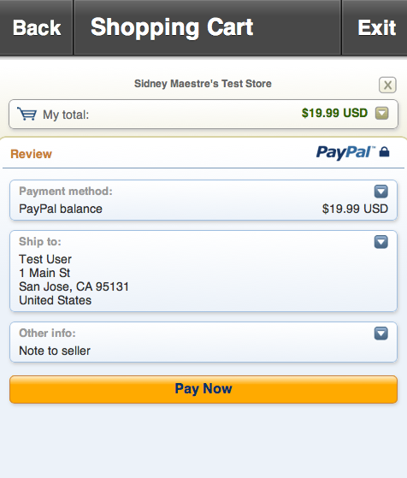
Pay Now

Slide 64
Project on github
https://github.com/paypalx/mec-flex-mobile-shop

Slide 65
Questions?
sidney@x.com
@SidneyAllen

